Slide 1
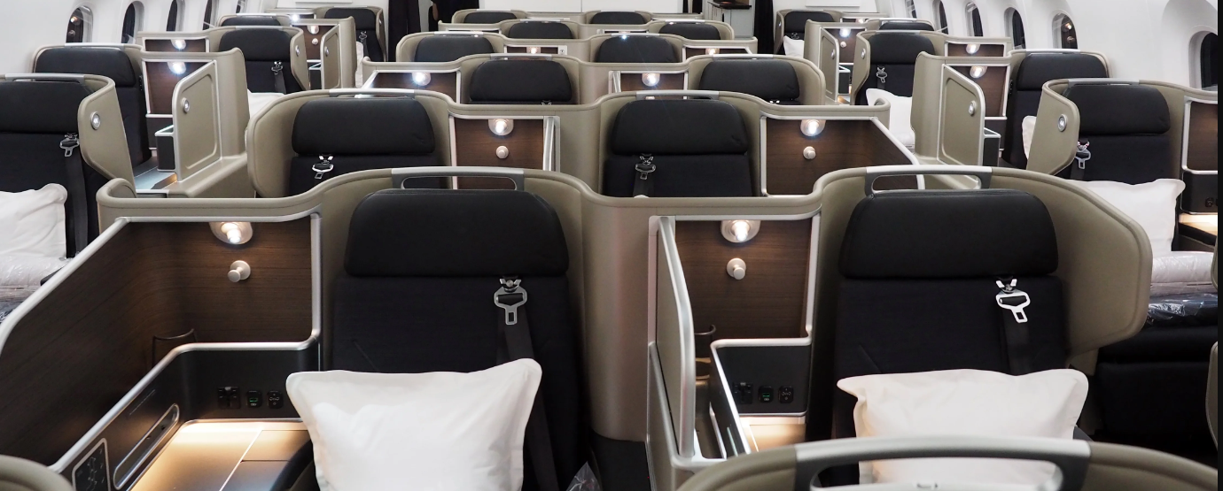
AIRLINE PASSENGER SATISFACTION
Team 7

Slide 2
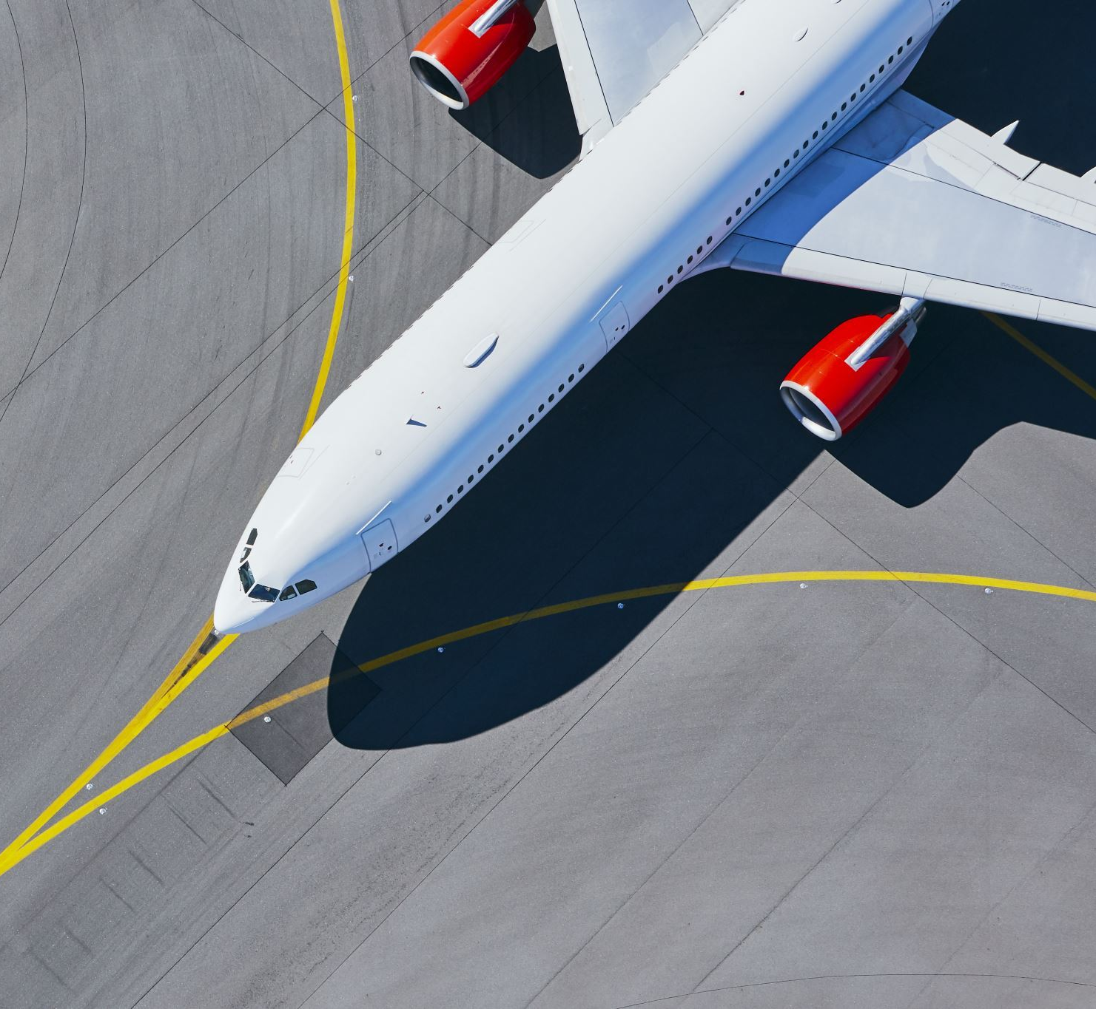
AIRLINES???
The airline industry is valued at $762.8 billion in 2023.
It ranks as the second largest global transportation system.
Approximately 100,000 flights take off and land worldwide each day.
Globally, around 7 billion passengers traveled by different airlines in 2022.
Surprisingly, about 20% of the world's population has never flown.
Alarmingly, 52% of air travelers in the United States express discomfort with their flight experiences, making it the second largest air travel market worldwide.

Slide 3

Details of the Dataset
Our dataset (sourced from Kaggle) contains 103,904 records of airline customer ratings, capturing passengers' travel experiences and feedback.
It comprises attributes that delineate diverse flight characteristics and performance metrics, providing comprehensive flight-related information.
We aim to construct a comprehensive data analysis model that correlates these variables with customer satisfaction, offering valuable insights.
Our objective here is to relate customer characteristics and customer experience to the satisfaction of the customers.

Slide 4
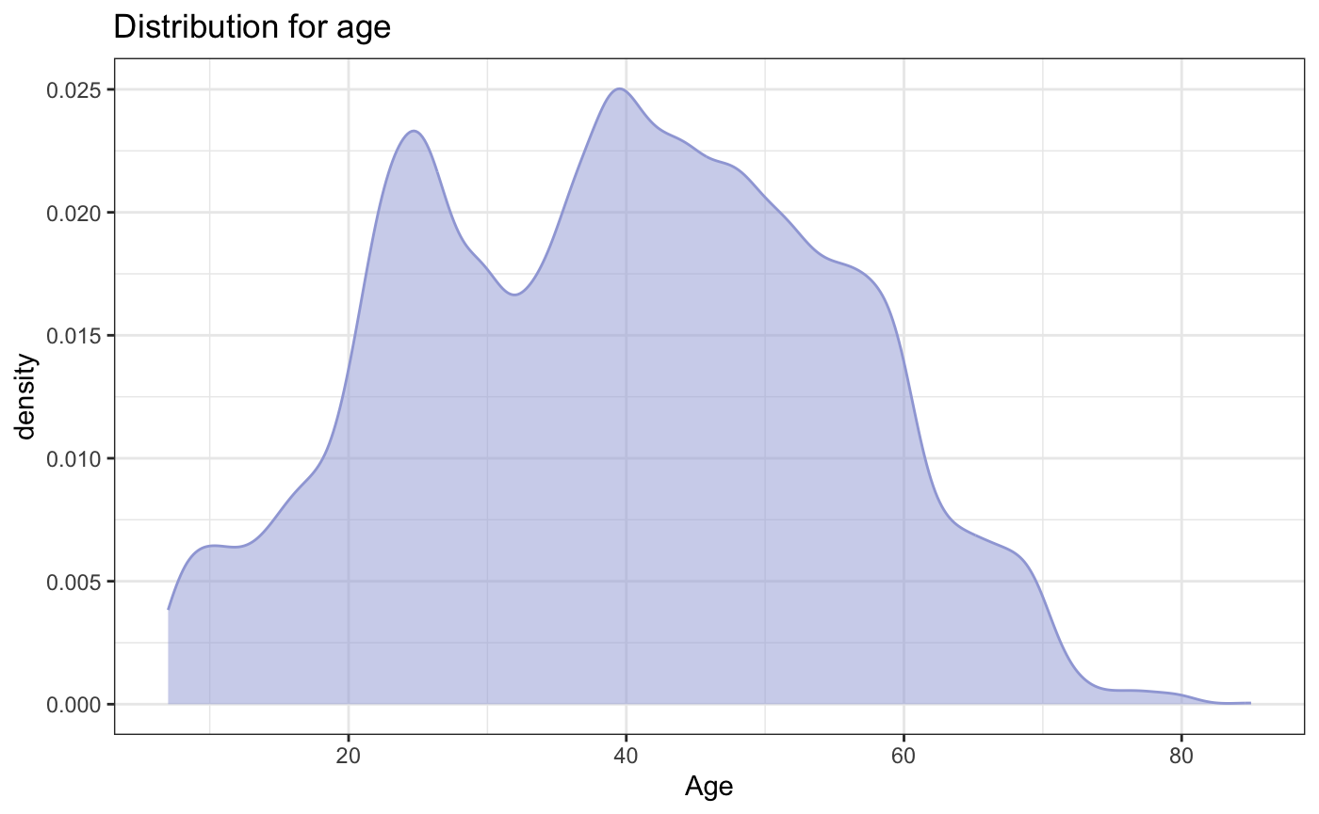
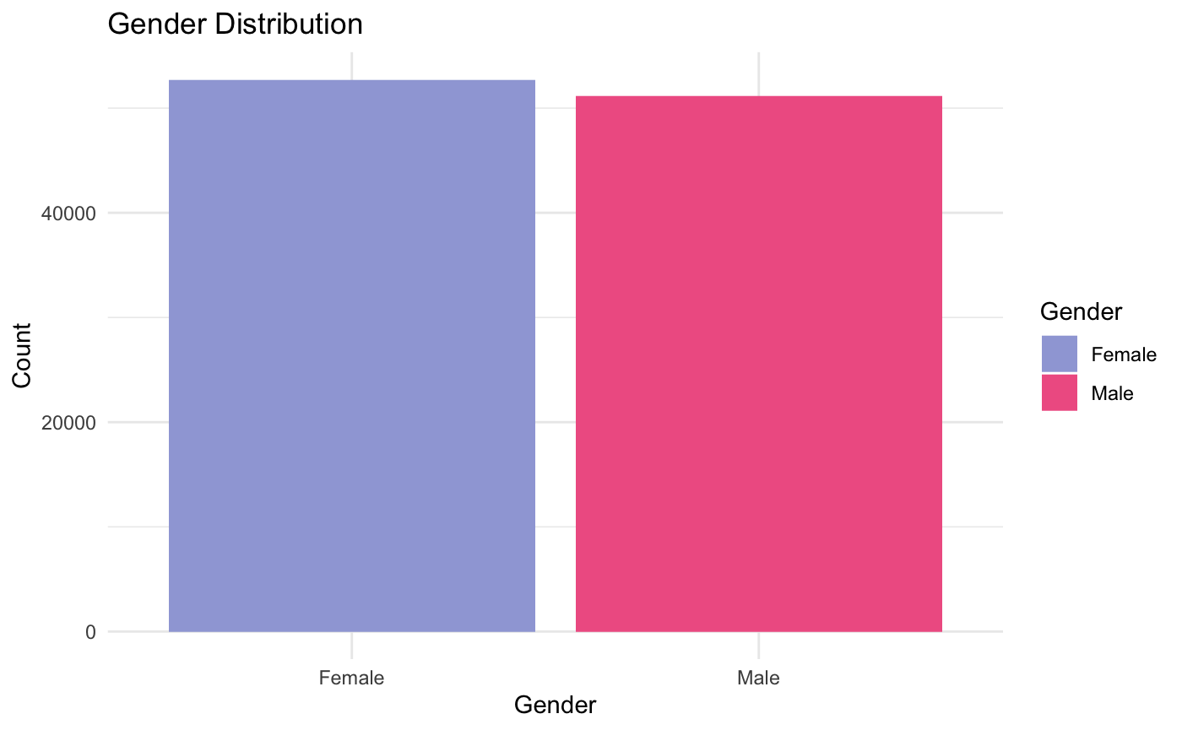
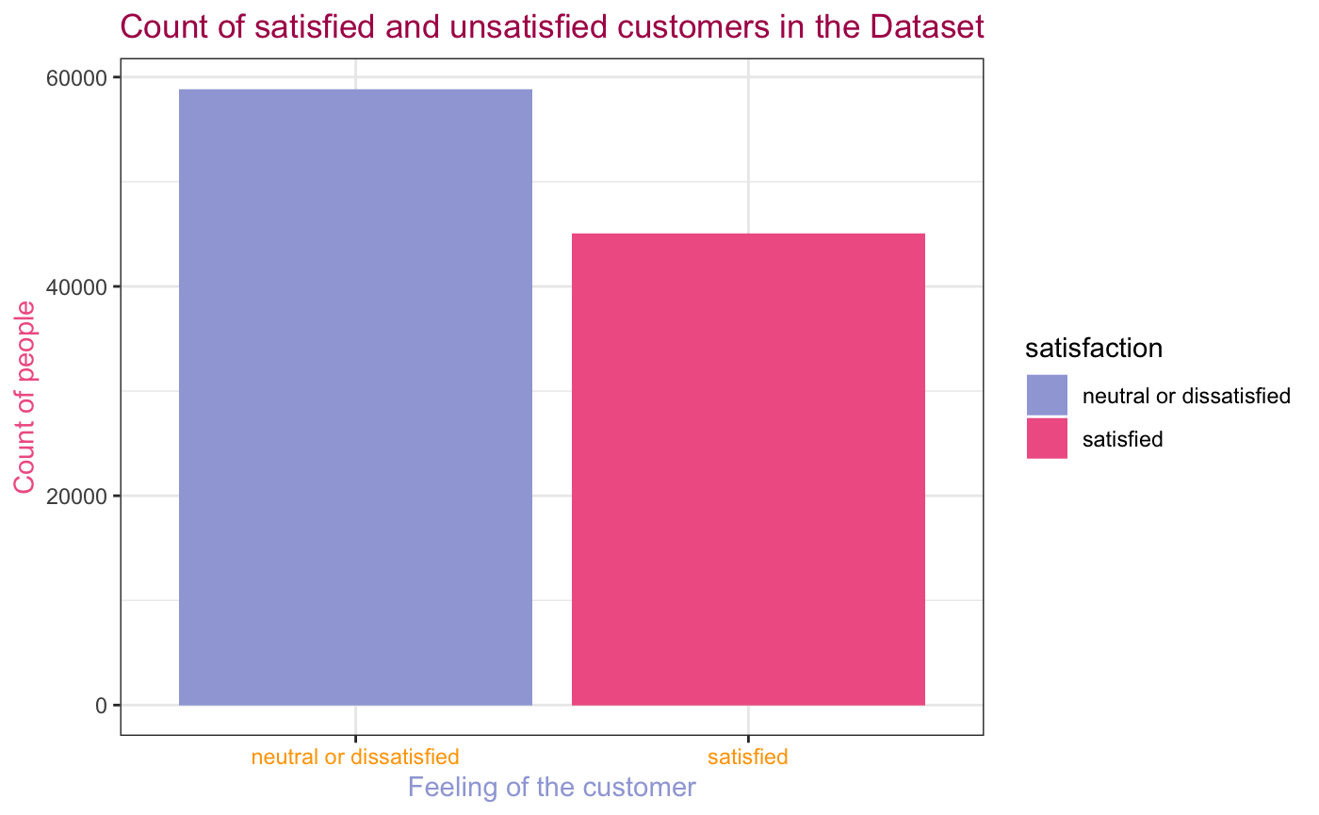
What are the distributions based on the different attributes in the dataset?
The age distribution graph exhibits characteristics resembling a normal distribution, with a central tendency represented by a mean age of 40.
The number of dissatisfied customers exceeds the count of satisfied customers.
The number of female customers is a little bit more than the male customers.

Slide 5
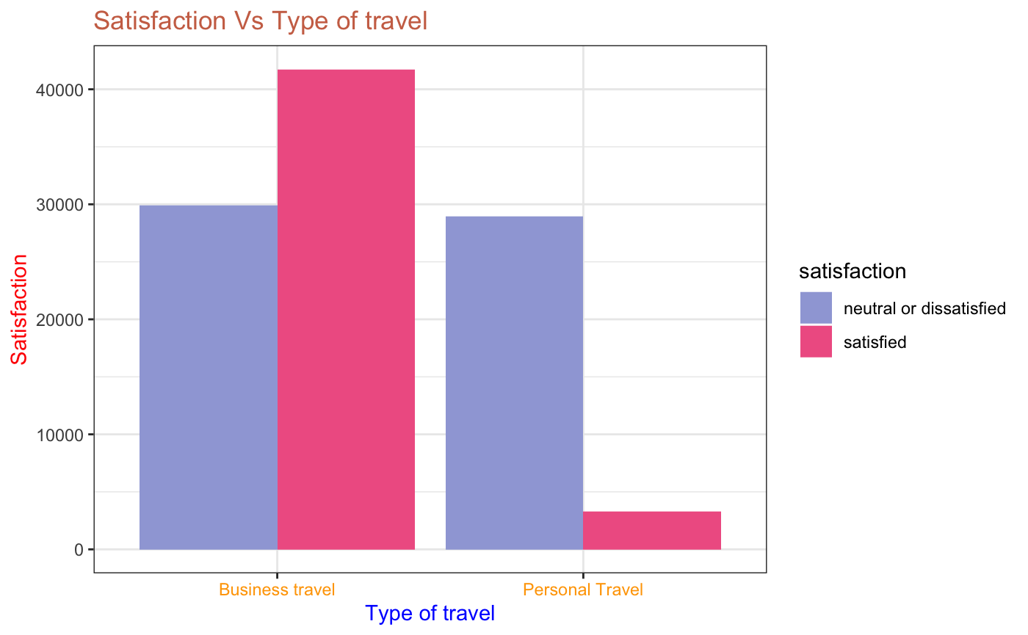
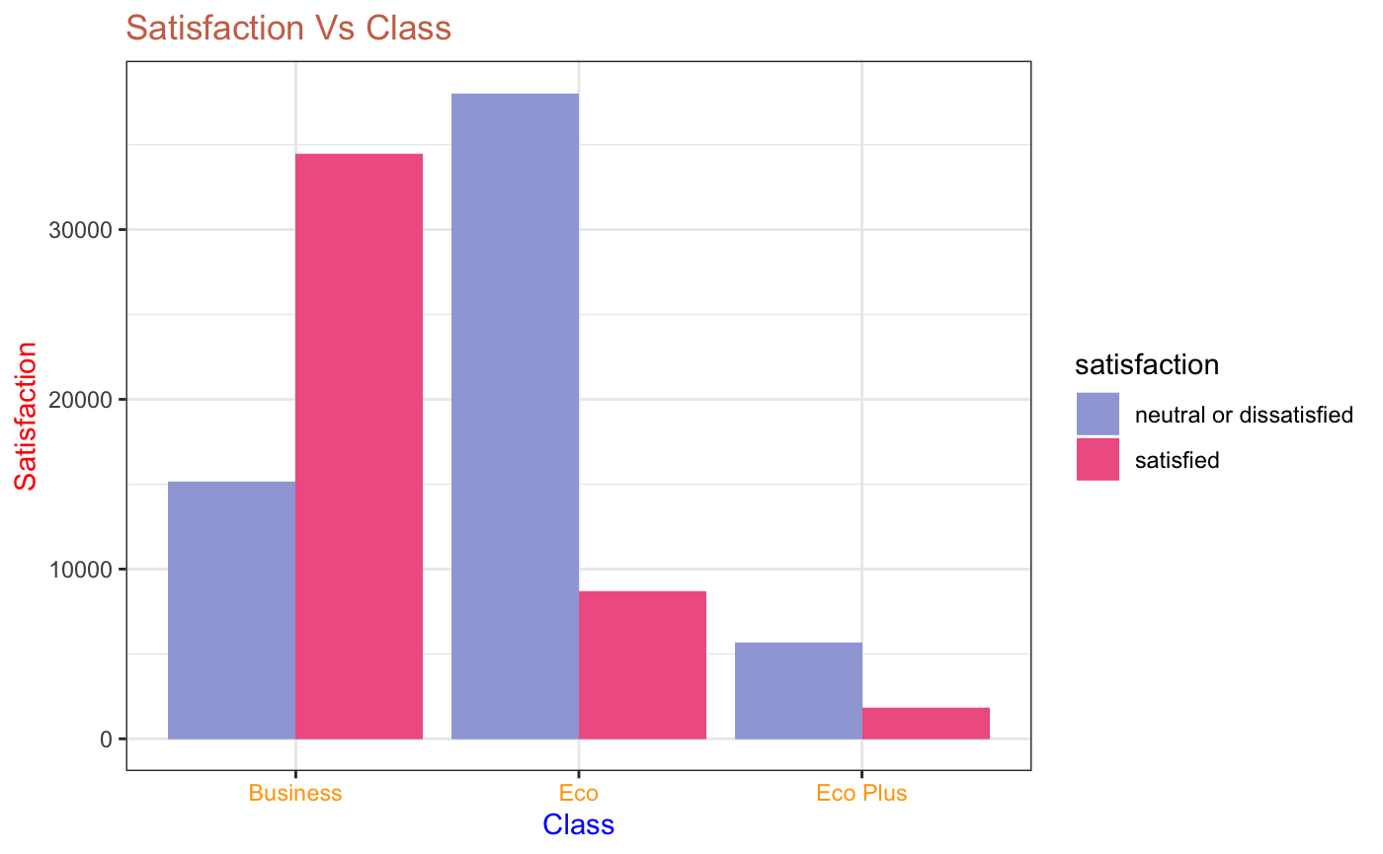
Are There Any Satisfaction Trends That Correspond With A Person's Type Of Travel And Class Of Flight?
The graph on the left depicts that business travellers are predominantly satisfied, while personal travellers tend to be dissatisfied, reflecting distinct customer sentiments in the travel class.
The bar chart on the right depicts that the customers in the business class exhibit higher satisfaction, while those in the economy class and economy plus class tend to express greater dissatisfaction, highlighting varying levels of contentment in these travel segments.

Slide 6
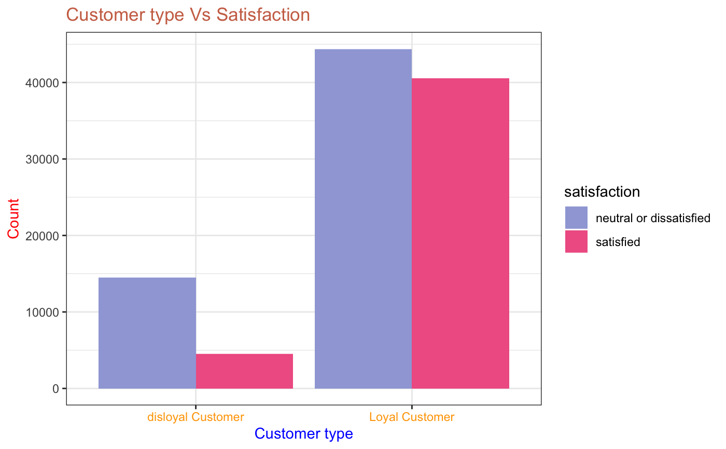
Is Satisfaction Affected By Customer Type?
The graph highlights that disloyal customers are significantly more dissatisfied than satisfied, whereas loyal customers show a more balanced sentiment.

Slide 7
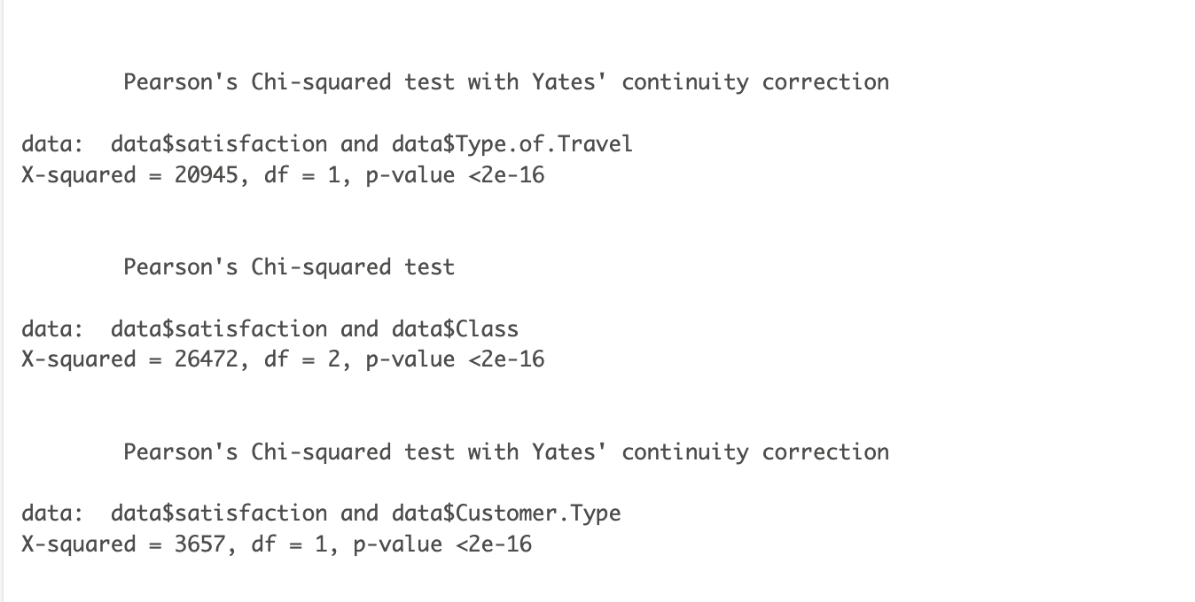
Statistical significance of type, class of travel and customer type on satisfaction of the customer
We conducted a 𝛘² test between satisfaction and type of travel, Class, and type of Customer
H₀ = Satisfaction is independent of the type of travel, class and type of Customer
H_{A} = Satisfaction is dependent on the type of travel, class and type of Customer

Slide 8
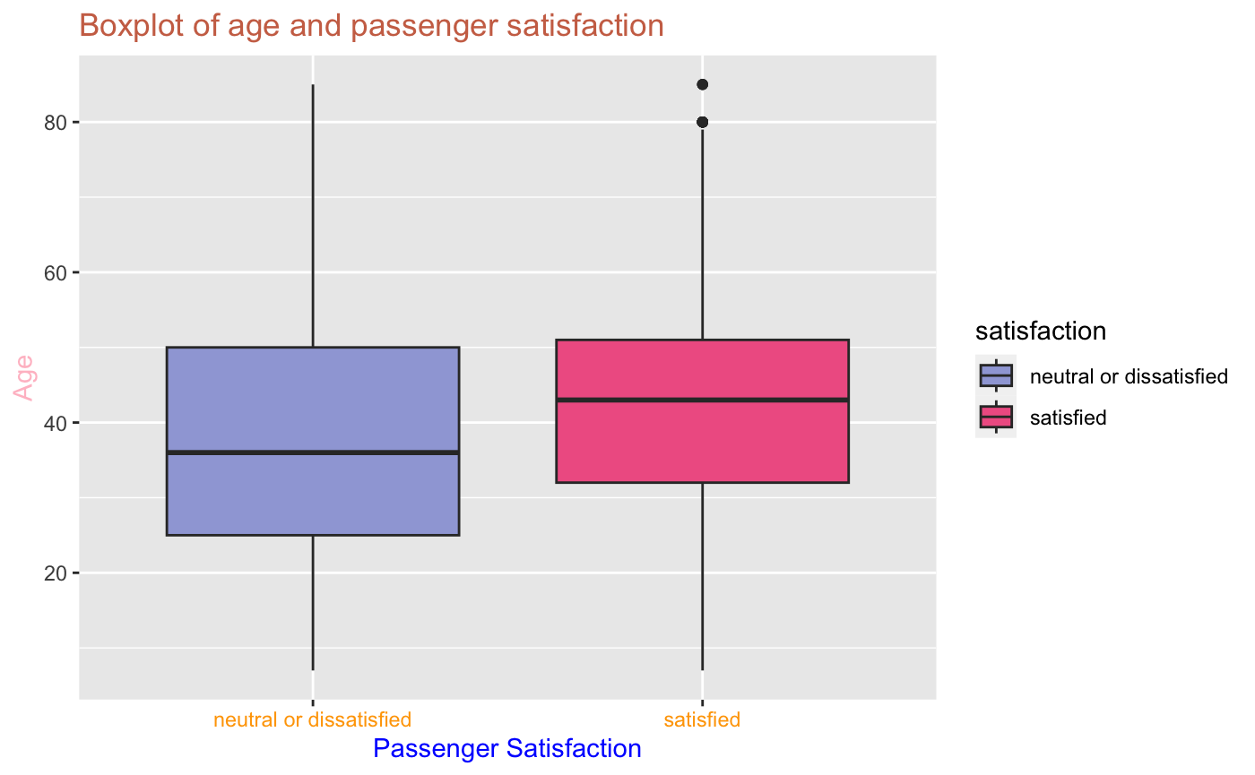
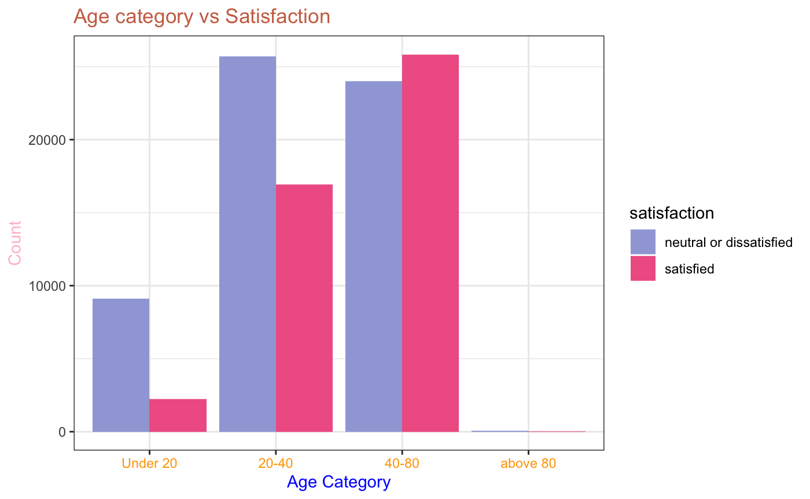
Is There A Connection Between Passengers' Ages And Their Degrees Of Satisfaction?
The boxplot suggests that older customers tend to exhibit higher levels of satisfaction compared to their younger counterparts.
The age distribution bar graph reveals that customers under 40 express greater dissatisfaction, while older age groups exhibit higher satisfaction levels.

Slide 9
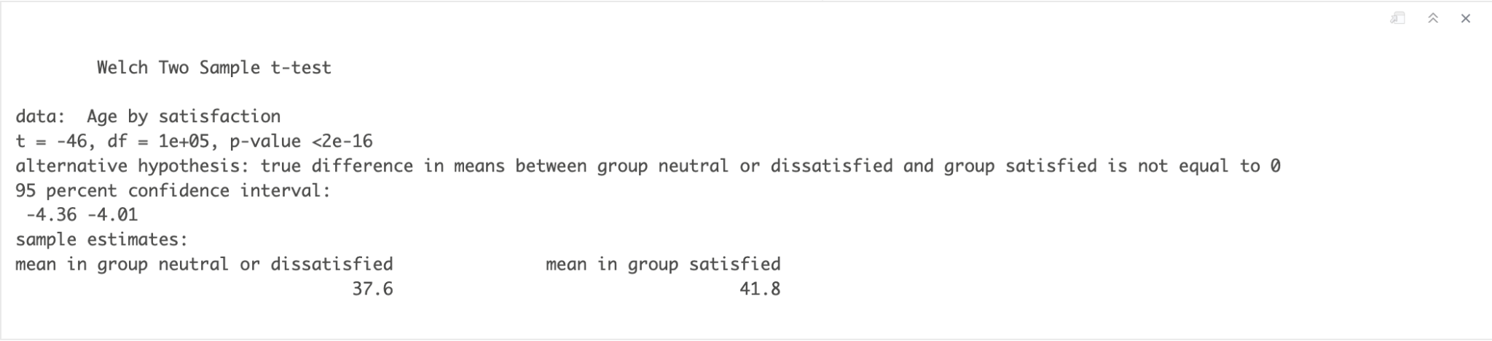
To understand the variation of satisfaction levels across different age groups, we performed a Welch Two Sample t-test on the age and satisfaction variables.
Here, H₀ = The mean of the ages of the satisfied passengers compared to the mean of the ages of the dissatisfied/neutral passengers are the same.
and H_{A} = The mean of the ages of the satisfied passengers compared to the mean of the ages of the dissatisfied/neutral passengers are not the same.

Slide 10
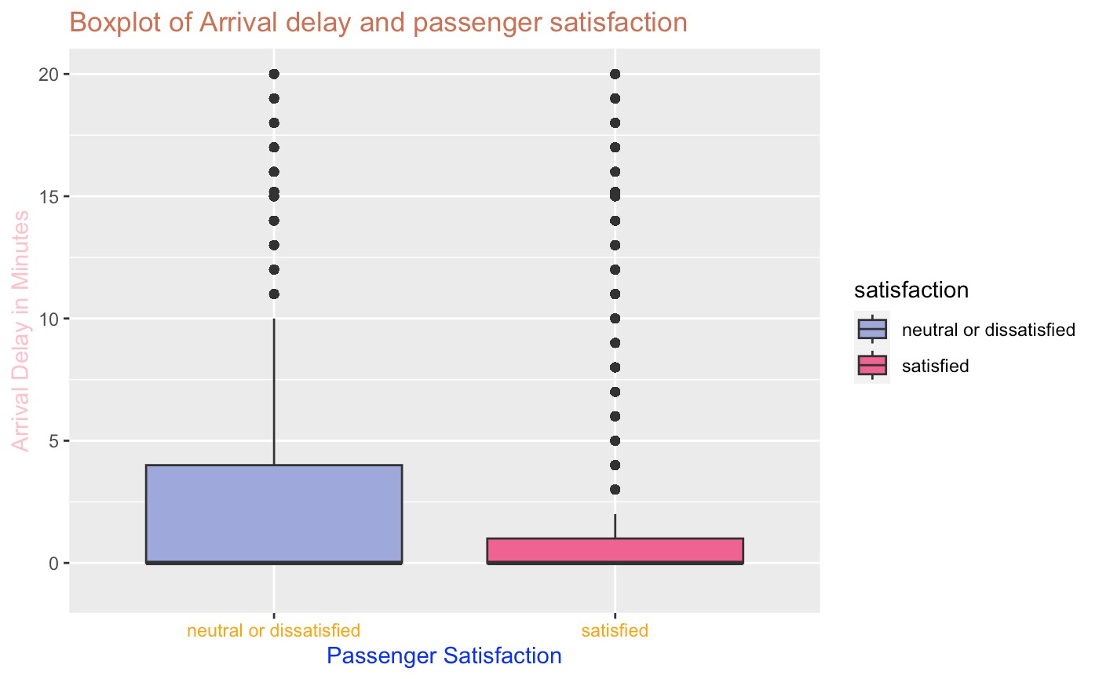
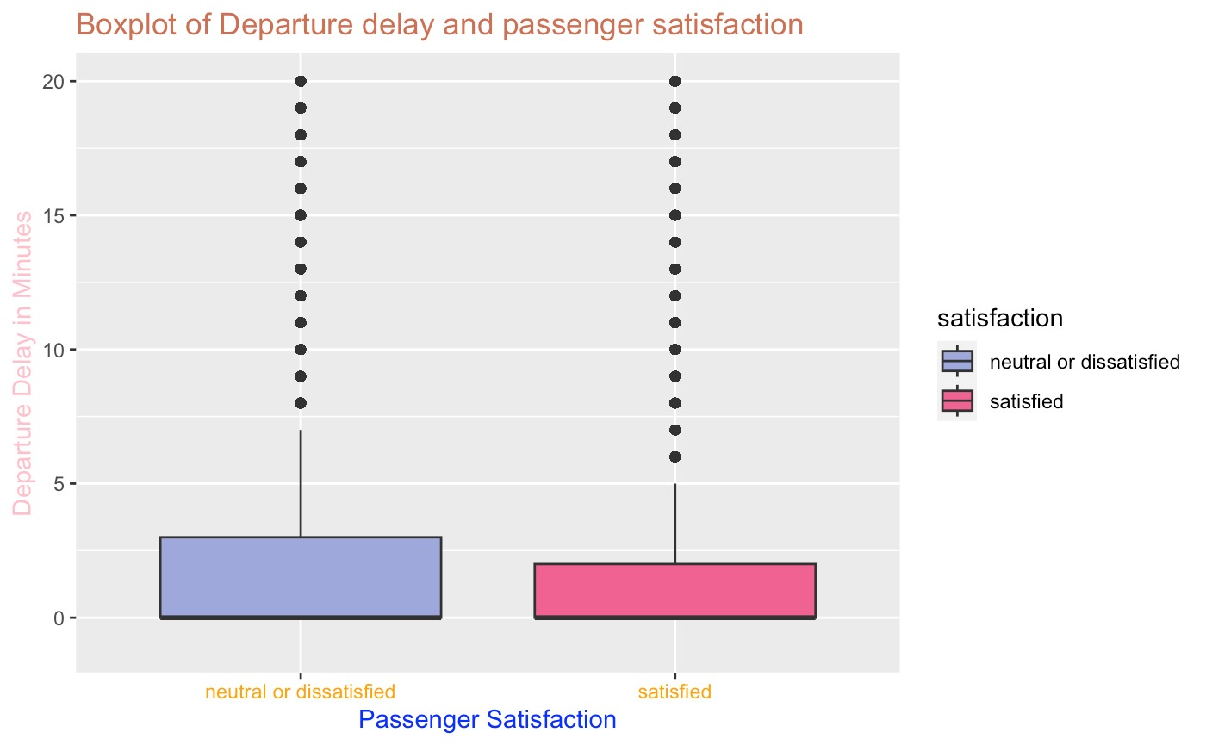
Is there a relationship of any kind between overall satisfaction and flying distance?

Slide 11
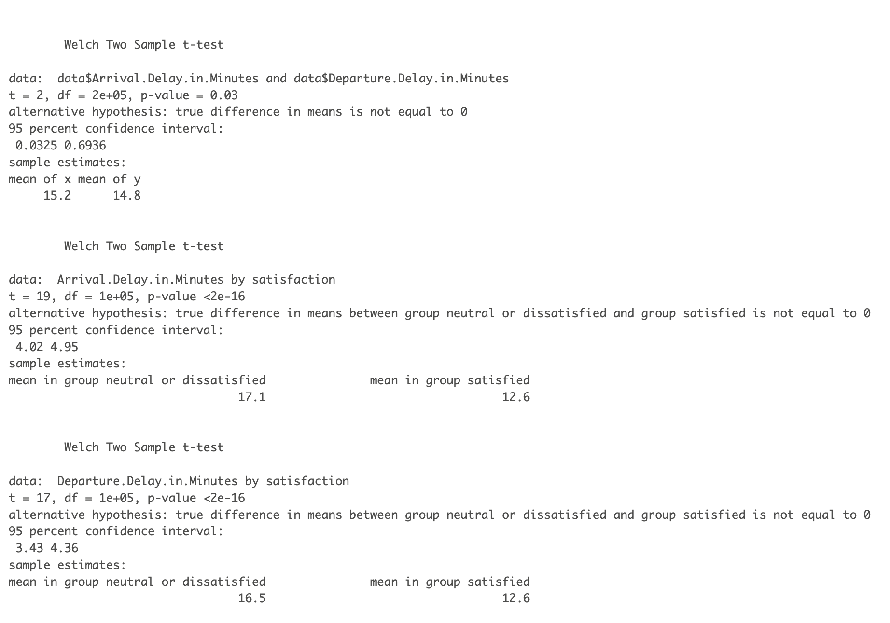
Arrival vs Delay: A Statistical Insight
The first t-test above is an independent t-test between Arrival and Departure Delay in Minutes.
Then, the next two t-tests have been conducted on customer satisfaction and delays in Arrival and Departure (in minutes).

Slide 12
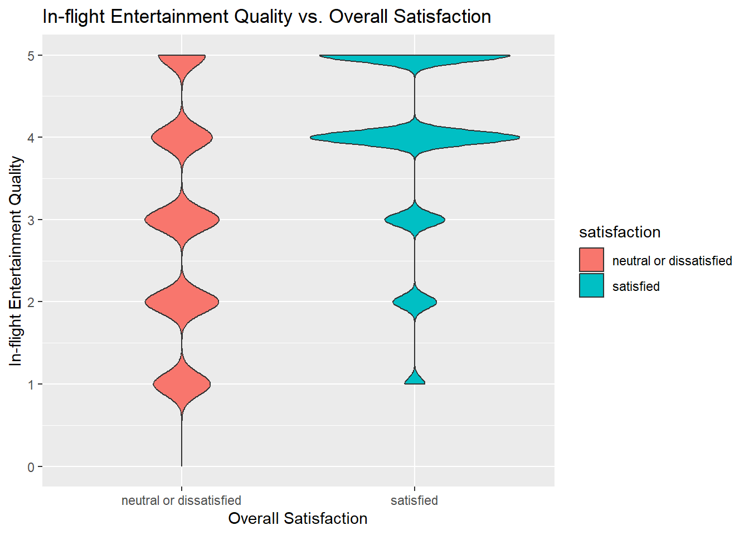
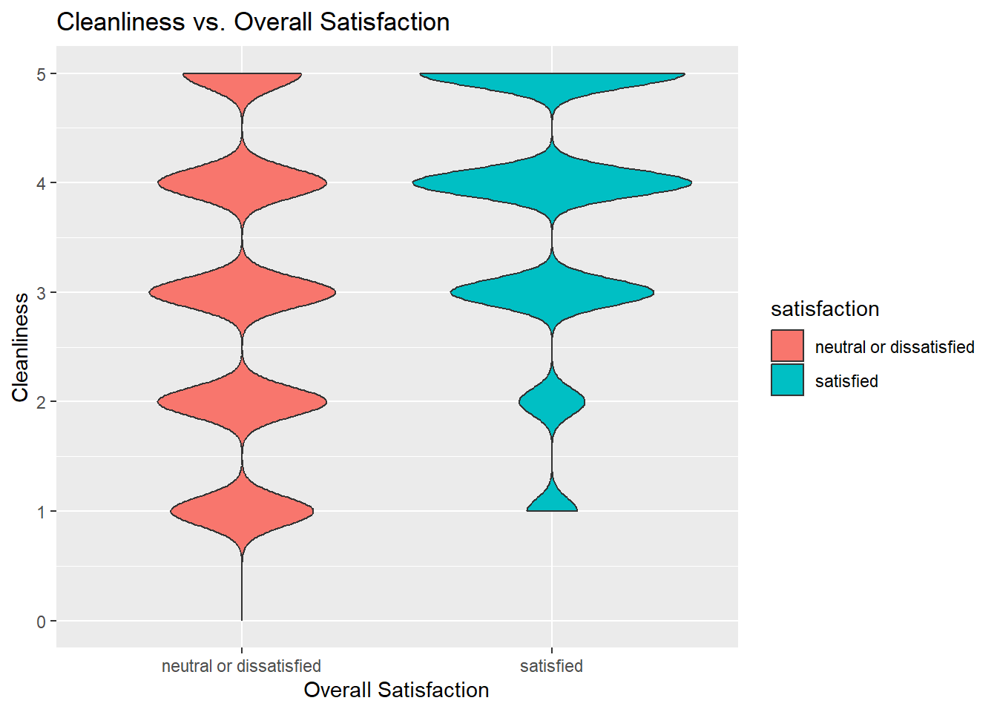
How does the overall satisfaction score affect the quality of the in-flight entertainment?
What is the relationship between satisfaction with food and drink services and cleanliness?
The number of customers whose overall satisfaction is satisfied has given a moderate rating for the inflight entertainment where most of them have given rating of 4 whereas unsatisfied customers were compatible and given rating from 1 to 5.
In the aspect of cleanliness, most of satisfied customers rated 3 and 4, whereas dissatisfied customers were evenly spread from 1 to 5, so this tells us that cleanliness effects the overall satisfaction.

Slide 13
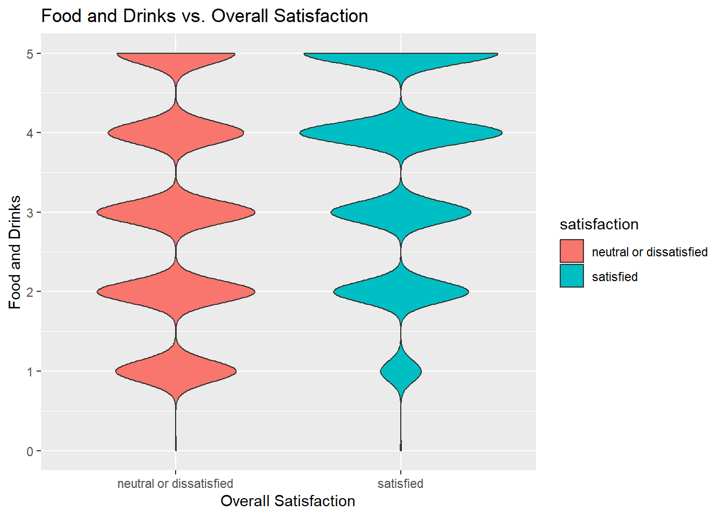
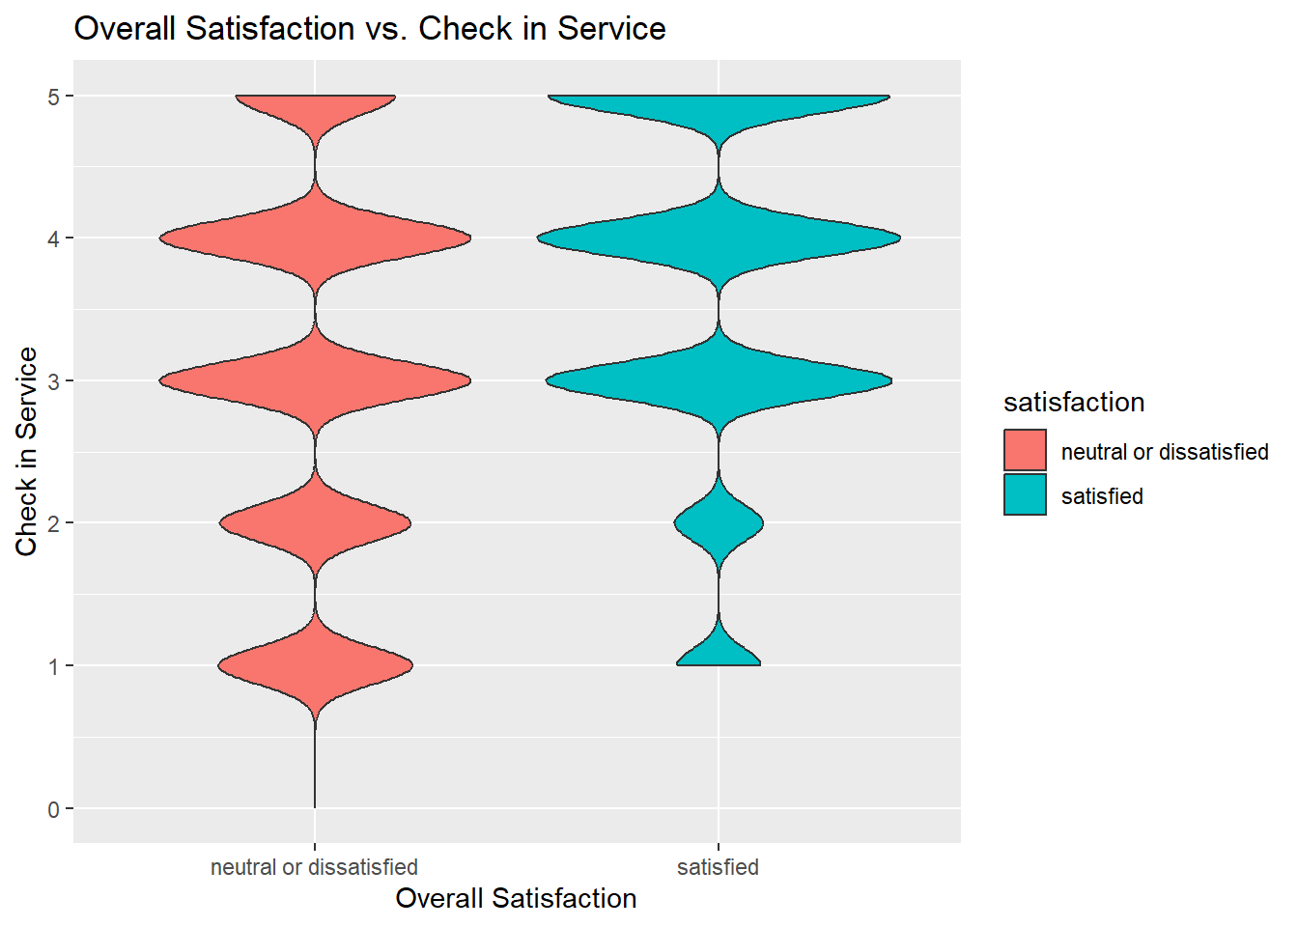
Overall Satisfaction
vs
Food and Drinks
Check-in Service
The majority of satisfied customers gave a rating of 4 for food and drinks, with a small minority rating it as low as 2 or 3. In contrast, unsatisfied customers had a wider range of ratings spanning from 1 to 5.
The plot illustrates that satisfied customers generally provided a moderate rating for the check-in service, while unsatisfied customers' ratings varied widely from 1 to 5.

Slide 14
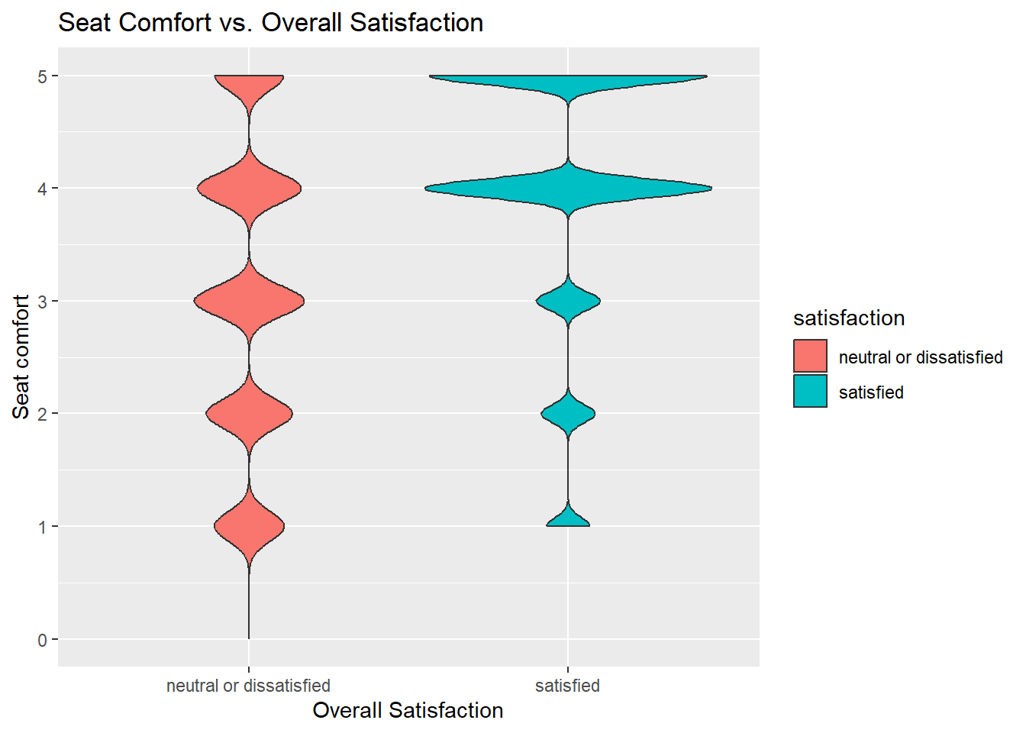
Seat Comfort vs Overall Satisfaction
Seat comfort is essential for passenger satisfaction across all modes of travel.
The plot reveals intriguing patterns: most satisfied customers rated seat comfort as 4 or 5, while unsatisfied customers' ratings ranged from 1 to 5, indicating a more moderate satisfaction level.
Notably, all satisfied customers provided ratings above 0 for seat comfort, whereas unsatisfied customers included some who rated it as 0.

Slide 15
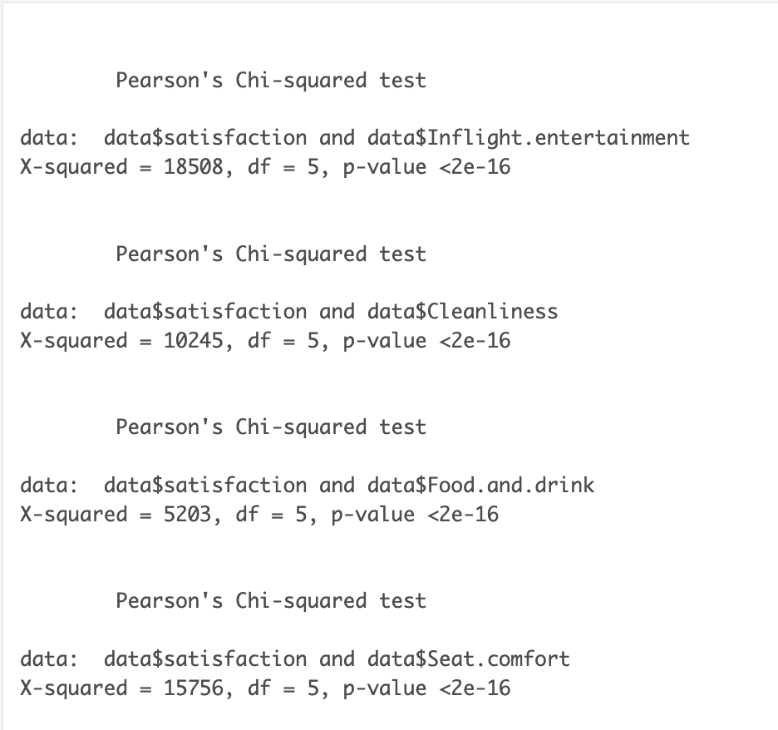
We conducted a 𝛘2 test between customer satisfaction and inflight entertainment, cleanliness, food and drink options and seat comfort.
We conducted a 𝛘² test between customer satisfaction and inflight entertainment, cleanliness, food and drink options and seat comfort.
H₀ = Satisfaction is independent of the inflight entertainment, cleanliness, food and drink options and seat comfort.
H_{A} = Satisfaction is dependent on inflight entertainment, cleanliness, food and drink options and seat comfort.

Slide 16
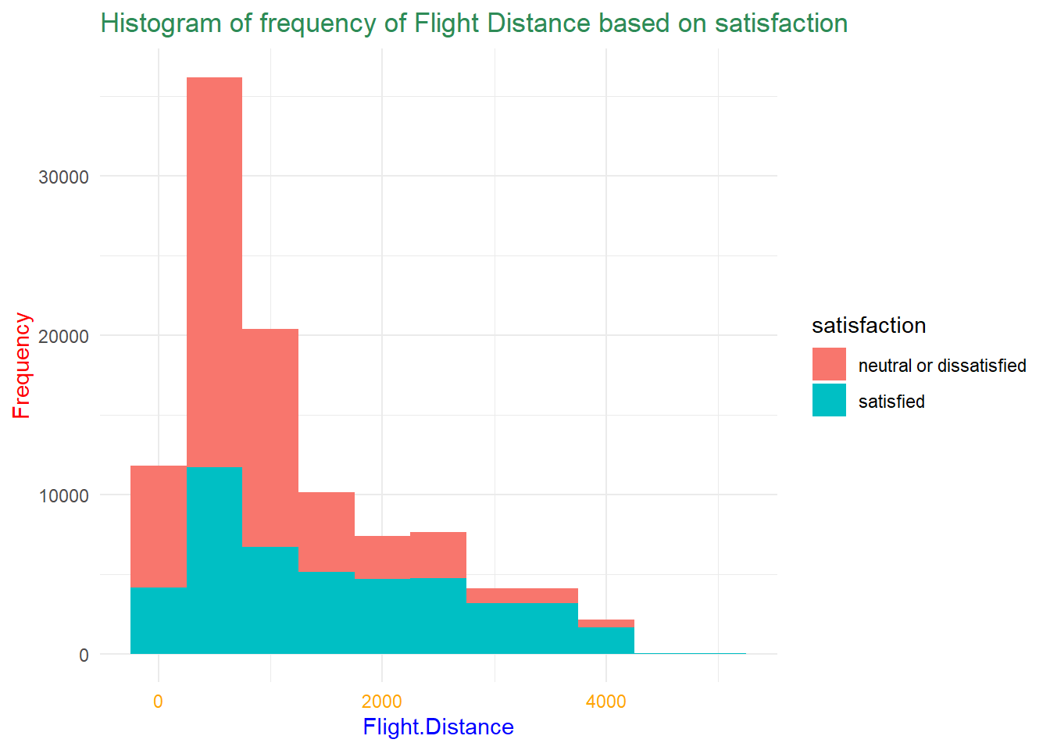
Satisfaction vs Flight Distance
When it comes to airline travel, there are numerous routes available from point A to point B; however, the selection of a route is a critical decision due to various protocols and regulations.
Histogram depicts that few satisfied customers had travelled only within 0-2000 nautical miles.
Most travelers expressed dissatisfaction with flight distances.
Airlines must prioritize optimal routes for customer satisfaction.

Slide 17
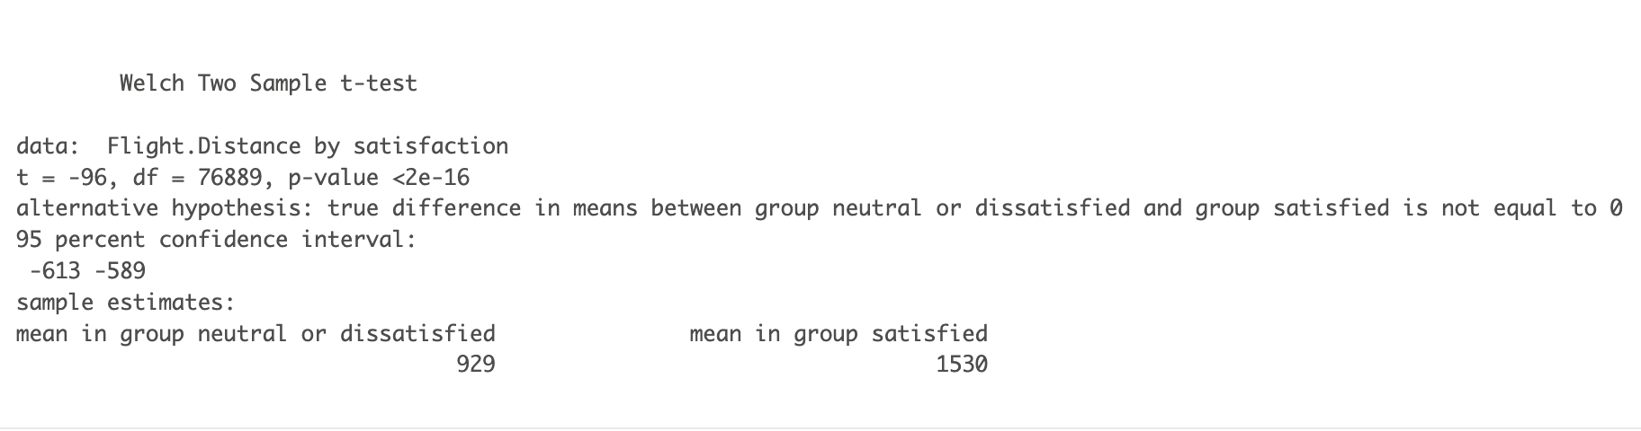
In order to understand the variation of satisfaction levels versus flight distance, we performed a Welch Two Sample t-test on the satisfaction and flight distance variables.
Here, H₀ = The mean of the number of satisfied passengers compared to the mean of number of dissatisfied/neutral passengers based on flight distance are the same.
and, H_{A} = The mean of the number of satisfied passengers compared to the mean of number of dissatisfied/neutral passengers based on flight distance are not the same.

Slide 18
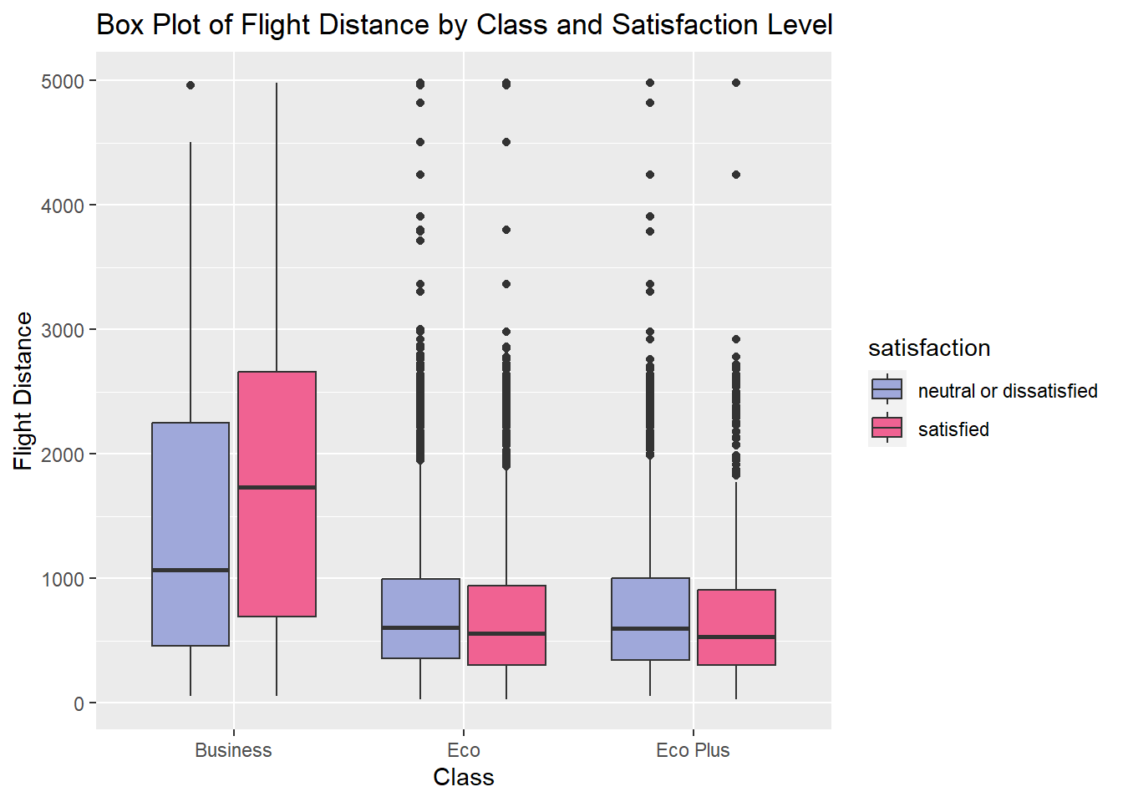
Flight Distance vs Class based on Satisfaction
The plot suggests that passengers traveling between 2000 and 3000 nautical miles exclusively opted for business class, while Economy and Economy Plus (Eco Plus) travelers covered a maximum distance of 1000 nautical miles.

Slide 19
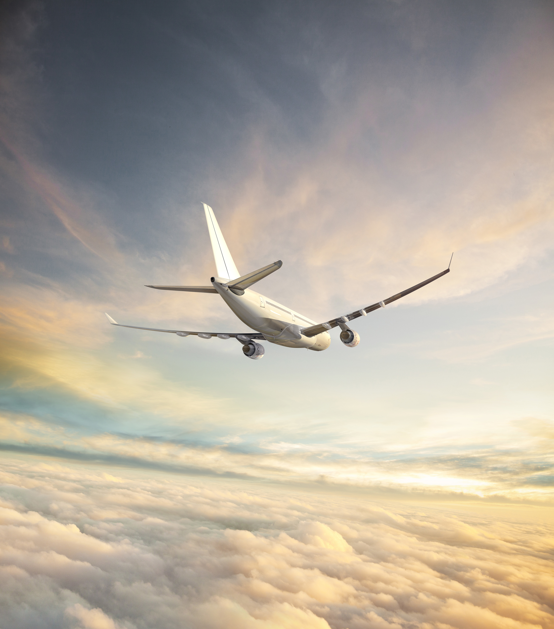
CONCLUSION
In conclusion, a variety of demographic statistics, service quality attributes, and flight-related variables all have a major impact on customer satisfaction.
These insights are quite valuable and will help any airline make necessary changes that will not only improve overall customer satisfaction but also attract more customers.
By incorporating customer ratings into their decision-making process and implementing changes based on the analysis performed, airlines can take a significant step towards enhancing the overall flying experience for passengers. This customer-centric approach is likely to not only improve customer satisfaction but also contribute to an increase in the number of passengers, as travelers are more likely to choose those airlines that actively listen to and address their concerns.

Slide 20
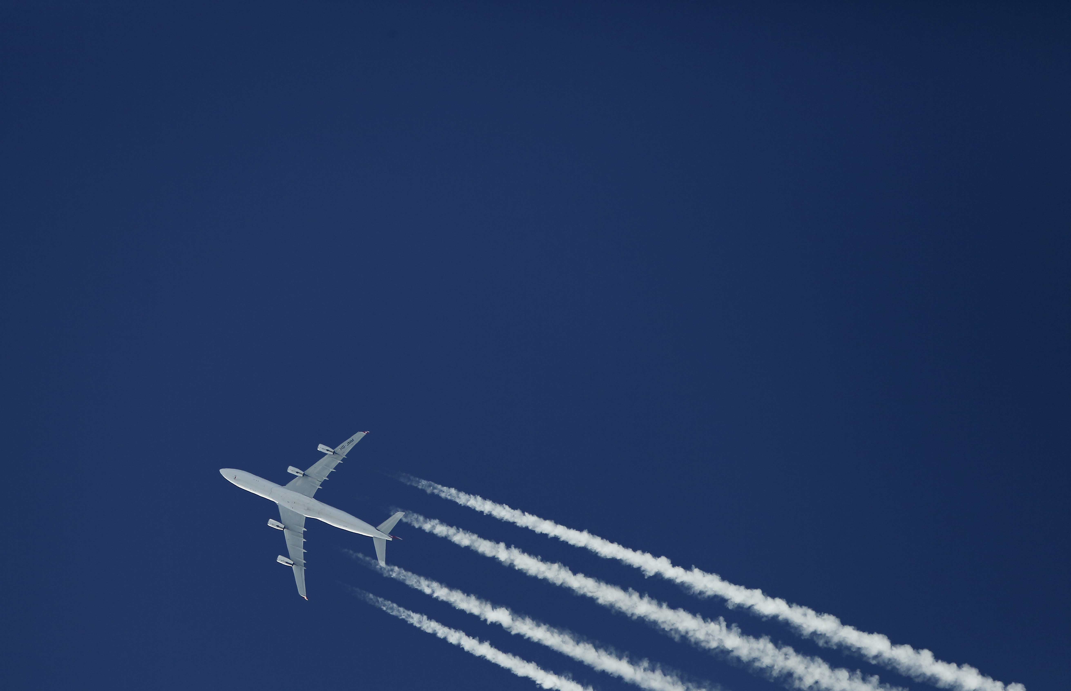
THANK YOU!
-TEAM 7

